Slide 1
Interrupts in 8051

Slide 2
Interrupts vs Polling
An interrupt is an external or internal event that interrupts the microcontroller to inform it that a device needs its service
A single microcontroller can serve several devices by two ways
Interrupts
Whenever any device needs its service, the device notifies the microcontroller by sending it an interrupt signal
Upon receiving an interrupt signal, the microcontroller interrupts whatever it is doing and serves the device
The program which is associated with the interrupt is called the interrupt service routine (ISR) or interrupt handler

Slide 3
Interrupts vs Polling
Polling
The microcontroller continuously monitors the status of a given device
When the conditions met, it performs the service
After that, it moves on to monitor the next device until every one is serviced
Polling can monitor the status of several devices and serve each of them as certain conditions are met
The polling method is not efficient, since it wastes much of the microcontroller’s time by polling devices that do not need service
ex. JNB TF,target

Slide 4
Interrupts vs Polling
The advantage of interrupts is that the microcontroller can serve many devices (not all at the same time)
Each devices can get the attention of the microcontroller based on the assigned Priority
The microcontroller can also ignore(mask) a device request for service
This is not possible for the polling method

Slide 5
INTERRUPTS Interrupt Service Routine
For every interrupt, there must be an interrupt service routine (ISR), or interrupt handler
When an interrupt is invoked, the microcontroller runs the interrupt service routine
For every interrupt, there is a fixed location in memory that holds the address of its ISR
The group of memory locations set aside to hold the addresses of ISRs is called interrupt vector table

Slide 6
Reset – power-on reset
When reset pin is activated, the program execution flow jumps to execute code from 0000H memory location It is also known as power-on reset.
Two interrupts are set aside for the timers:
one for timer 0 and one for timer 1
A timer interrupt informs the microcontroller that the corresponding Timer has finished the counting.
Two interrupts are set aside for hardware external interrupts
An external interrupt informs the microcontroller that an external device needs its routine service.
P3.2 and P3.3 are for the external hardware interrupts INT0 (or EX1), and INT1 (or EX2)
Serial communication has a single interrupt that belongs to both receive and transfer
When enabled, it notifies the controller whether a byte has been received or transmitted

Slide 7
8051 Interrupt Structure
Interrupt | ROM Location(Hex) | Pin | Flag Clearing | Interrupt no. in C
Reset | 0000 | 9 | Auto | --
External HW Interrupt 0 (INT0) | 0003 | P3.2(12) | Auto | 0
Timer 0 Interrupt(TF0) | 000B | - | Auto | 1
External HW Interrupt 1 (INT1) | 0013 | P3.3(13) | Auto | 2
Timer 1 Interrupt(TF1) | 001B | - | Auto | 3
Serial Com Interrupt(RI and TI) | 0023 | - | Program SW | 4

Slide 8
The reset vector has just 3 bytes allocated to it, meaning it can hold a jump instruction to the location where the main program is stored.
The other interrupts have 8 bytes, a small (ISR) can be placed here.
If the ISR needs larger space, it has to placed else where and the allocated 8 bytes need to have the code that simple redirects the control to the ISR.
.
Timers and Serial interrupts are internally generated by the microcontroller
External interrupts are generated when externally interfacing devices or switches are connected to the microcontroller.
These external interrupts can be edge-triggered or level triggered

Slide 9
Enabling and Disabling an Interrupt
Upon reset, all interrupts are disabled (masked), meaning that none will be responded to by the microcontroller if they are activated
The interrupts must be enabled by software in order for the microcontroller to respond to them
There is a register called IE (interrupt enable) that is responsible for enabling (unmasking) and disabling (masking) the interrupts

Slide 10
PROGRAMMING INTERRUPTS

Slide 11
Enabling and Disabling an Interrupt
To enable an interrupt, we take the
following steps:
1. Bit D₇ of the IE register (EA) must be set to high to allow the rest of register setting to take effect
2. The value of EA
If EA = 1, interrupts are enabled and will be responded to if their corresponding bits in IE are high
If EA = 0, no interrupt will be responded to even if the associated bit in the IE register is high

Slide 12
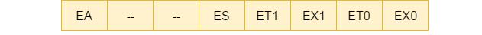
Programming Interrupts
Specify the microcontroller which interrupts must be served by configuring the Interrupt Enable (IE) register which enables or disables the various available interrupt
IE register is bit addressable and individual interrupt bits can also be accessed.
For example –
IE = 0x81; enables External Interrupt0 (EX0)
IE = 0x90; enables Serial Interrupt
Setting the bits of IE register is necessary and sufficient to enable the interrupts

Slide 13
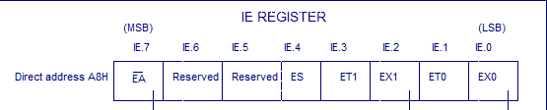
Enabling and Disabling an Interrupt
Show the instructions to
(a) enable the serial interrupt, timer 0 interrupt, and external hardware interrupt 1 (EX1),and (b) disable (mask) the timer 0 interrupt, then (c) show how to disable all the interrupts with a single instruction.
Solution:
(a) MOV IE,#10010110B ;enable serial timer 0, EX1
Another way to perform the same manipulation is
SETB IE.7 ;EA=1, global enable
SETB IE.4 ;enable serial interrupt
SETB IE.1 ;enable Timer 0 interrupt
SETB IE.2 ;enable EX1
(b) CLR IE.1 ;mask (disable) timer 0 ;interrupt only
(c) CLR IE.7 ;disable all interrupts

Slide 14
2. Specify the controller what to do when an interrupt occurs with the ISR
ISR gets automatically called when an interrupt occurs.
It is not required to call the Interrupt Subroutine explicitly in the code.
Subroutine must have the keyword interrupt followed by the interrupt number.
A subroutine for a particular interrupt is identified by this number.
These subroutine numbers corresponding to different interrupts are tabulated below.
Number | Interrupt | Symbol
0 | External 0 | EX0
1 | Timer 0 | IT0
2 | External 1 | EX1
3 | Timer1 | IT1
4 | Serial | ES
5 | Timer2 | ET2

Slide 15
Interrupt routine for Timer1
void ISR_timer1(void) interrupt 3
{
<Body of ISR>
}
Interrupt routine for External Interrupt0 (EX0)
void ISR_ex0(void) interrupt 0
{
<Body of ISR>
}
Note that the interrupt subroutines always have void return type. They never return a value

Slide 16
TIMER INTERRUPTS

Slide 17
TIMER INTERRUPTS
If the timer interrupt in the IE register is enabled, whenever the timer rolls over, TF is raised, and the microcontroller is interrupted in whatever it is doing, and jumps to the IVT to service the ISR
In this way, the microcontroller can do other tasks until it is notified that the timer has rolled over

Slide 18
1. Configure TMOD register to select timer(s) and its/their mode.
2. Load initial values in THx and TLx for mode 0 and 1;
or in THx only for mode 2.
3. Enable Timer Interrupt by configuring bits of IE register.
4. Start timer by setting timer run bit TRx.
5. Write subroutine for Timer Interrupt. The interrupt number is 1 for Timer0 and 3 for Timer1.
Note that it is not required to clear timer flag TFx.
6. To stop the timer, clear TRx at the end of subroutine.
Otherwise it will restart from 0000H in case of modes 0 or 1 and from initial values in case of mode 2.
7. If the Timer has to run again, it is required to reload initial values within the routine itself (in case of mode 0 and 1). Otherwise after one cycle timer will start counting from 0000H.

Slide 19
Timer interrupt to blink an LED; Time delay in mode1 using interrupt method
// Use of Timer mode0 for blinking LED using interrupt method // XTAL freq11.0592MHz
#include <reg51.h>
sbit LED = P1^0; //LED connected to D0 of port 1
void timer(void) interrupt 1 //interrupt no. 1 for Timer 0
{ led=~led; //toggle LED on interrupt
…..
…..
TR0 =0;
}
main( )
{ TMOD = 0x01; // mode1 of Timer0
TH0 = 0xFC; // initial values loaded to timer
TL0 = 0x66;
IE = 0x82; // enable interrupt
TR0 = 1; //start timer
while(1); // do nothing
}

Slide 20

EXTERNAL HARDWARE INTERRUPTS
The external interrupts are the interrupts received from the (external) devices interfaced with the microcontroller.
They are received at INTx pins of the controller.
Can be level triggered or edge triggered (decided by the TCON register)
Setting the IT0 and IT1 bits make the external interrupt 0 and 1 edge triggered respectively. By default these bits are cleared and so external interrupt is level triggered.
In level triggered, interrupt is enabled for a low at INTx pin
In edge triggering, interrupt is enabled for a high to low transition at INTx pin
TF1 | TR1 | TF0 | TR0 | IE1 | IT1 | IE0 | IT0

Slide 21
Write a routine for external interrupt. For EX0 (INT0), the interrupt number is 0 and for EX1 (INT1) interrupt number is 1.
For using external interrupt INT0 we have to write routine as:
void ISR_ex0 (void) interrupt 0
For using external interrupt INT1 we have to write routine as:
void ISR_ex1 (void) interrupt 2

Slide 22
Steps for using external interrupt
1. Enable external interrupt by configuring IE register.
2. Write routine for external interrupt. The interrupt number is 0 for EX0 and 2 for EX1 respectively.
//Level trigger external interrupt
void main()
{
IE = 0x81;
while(1);
}
void ISR_ex0(void) interrupt 0
{
<body of interrupt>
}
//Edge trigger external interrupt
void main()
{
IE = 0x84;
IT1 = 1;
while(1);
}
void ISR_ex1(void) interrupt 2
{
<body of interrupt>
}

Slide 23
Example
Write a program to use external interrupt INT0 of 8051 microcontroller.
Port 2 is used to monitor the output.
In the beginning, alternate values are passed to P2 LEDs.
When the external interrupt is given through a push-button, the Interrupt service routine will start to execute and LEDs output will get toggle for 1 sec.
This 1-sec delay is given through timer 0 when it is in mode 1.

Slide 24
void main()
{
P0 = 0x00; // Make all pins zero
P1 = 0x00; // Make all pins zero
P2 = 0x00; // Make all pins zero
P3 = 0x04; // making Port3 pin 2 high
IE=0x81; // Enable INT0 IT0=1;
// Set Falling Edge Trigger for INT0
while(1)
{ led1= 1;
led2= 0;
led3= 1;
led4= 0; } }
#include<reg51.h>
sbit led1= P2^0;
sbit led2= P2^1;
sbit led3= P2^2;
sbit led4= P2^3;
void ISR_ex0(void);
void Delay();

Slide 25
// Interrupt service routine function
void ISR_ex0(void) interrupt 0
// ISR for external interrupt INT0
{ led1=~led1;
led2=~led2;
led3=~led3;
led4=~led4;
Delay();
}
// Initialize delay with timer0
void Delay()
{ int i;
TMOD = 0x01; // Timer0 mode1 for(i=0;i<200;i++)
{
TH0=0xF8; //initial values for 1sec delay TL0=0xCC;
TR0 = 1; // timer0 start
while (TF0 == 0); // check overflow condition
TR0 = 0; // Stop Timer
TF0 = 0; // Clear flag
}
}

Slide 26
SERIAL COMMUNICATION BASICS

Slide 27
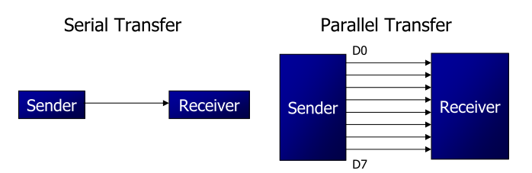
Computers transfer data in two ways:
Parallel
Often 8 or more lines (wire conductors) are used to transfer data to a device that is only a few feet away
Serial
To transfer to a device located many meters away, the serial method is used
The data is sent one bit at a time

Slide 28
At the transmitting end, the byte of data must be converted to serial bits using parallel-in-serial-out shift register
At the receiving end, there is a serial-in-parallel-out shift register to receive the serial data and pack them into byte
When the distance is short, the digital signal can be transferred as it is on a simple wire and requires no modulation
If data is to be transferred on the telephone line, it must be converted from 0s and 1s to audio tones,by a modem, “Modulator/demodulator”

Slide 29
SERIAL COMMUNICATION
Serial data communication uses two methods
Synchronous method transfers a block of data at a time
Asynchronous method transfers a single byte at a time
It is possible to write software to use either of these methods, but the programs can be tedious and long
There are special IC chips made by many manufacturers for serial communications
UART (universal asynchronous Receiver-transmitter)
USART (universal synchronous-asynchronous Receiver-transmitter)

Slide 30
Asynchronous serial data communication is widely used for character-oriented transmissions
Each character is placed in between start and stop bits, this is called framing
Block-oriented data transfers use the synchronous method
The start bit is always one bit, but the stop bit can be one or two bits
The start bit is always a 0 (low) and the stop bit(s) is 1 (high)

Slide 31
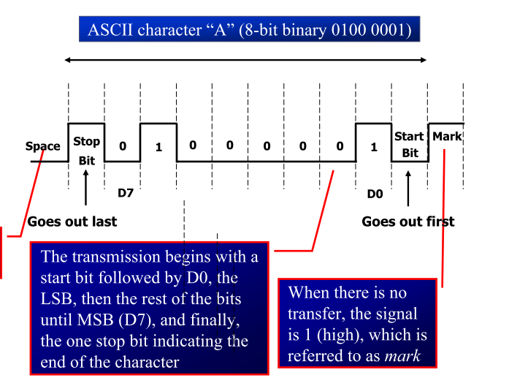


Slide 32
Assuming that we are transferring a text file of ASCII characters using 1 stop bit, we have a total of 10 bits for each character
This gives 25% overhead, i.e. each 8-bit character with an extra 2 bits
In some systems in order to maintain data integrity, the parity bit of the character byte is included in the data frame
UART chips allow programming of the parity bit for odd-, even-, and no-parity options

Slide 33
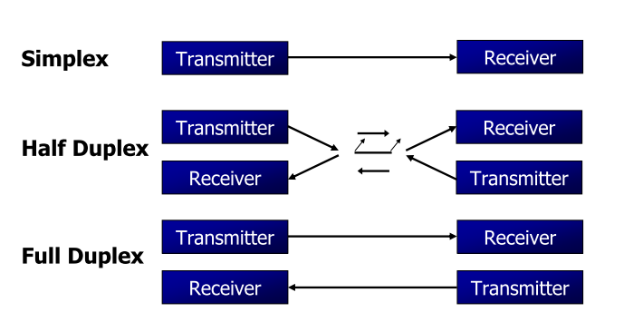
Half- and Full-Duplex Transmission
If data can be transmitted and received, it is a duplex
transmission
If data transmitted one way a time, it is referred to as half duplex
If data can go both ways at a time, it is full duplex
This is contrast to simplex transmission

Slide 34
Data Transfer Rate
The rate of data transfer in serial data communication is stated in bps(bits per second)
 Another widely used terminology for bps is baud rate
It is modem terminology and is defined as the number of signal changes per second
In modems, there are occasions when a single change of signal transfers several bits of data
As far as the conductor wire is concerned, the baud rate and bps are the same, and we use the terms interchangeably

Slide 35
Data Transfer Rate
The data transfer rate of given computer system depends on communication ports incorporated into that system
IBM PC/XT could transfer data at the rate of 100 to 9600 bps
Pentium-based PCs transfer data at rates as high as 56K bps
In asynchronous serial data communication, the baud rate is limited to 100K bps

Slide 36
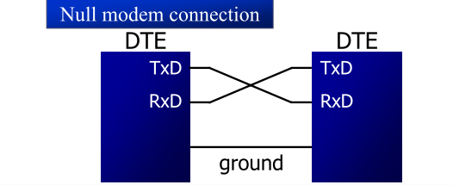
Current terminology classifies data communication equipment as DTE (data terminal equipment) refers to terminal and computers that send and receive data
DCE (data communication equipment) refers to communication equipment, such as modems
The simplest connection between a PC and microcontroller requires a minimum of three pins, TxD, RxD, and ground

Slide 37
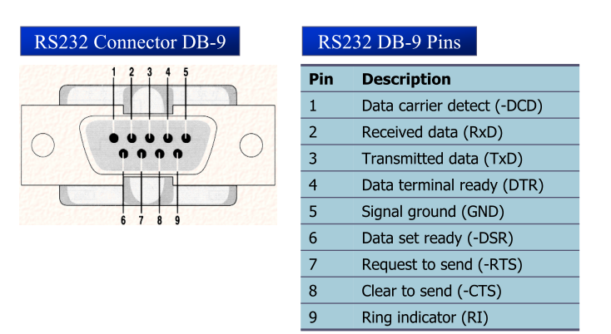
BASICS OF SERIAL COMMUNICATION RS232 Standards
An interfacing standard RS232 was set by the Electronics Industries Association (EIA) in 1960

Slide 38
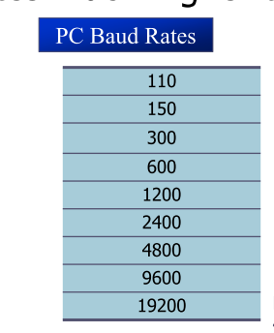
SERIAL COMMUNICATION PROGRAMMING
To allow data transfer between the PC and an 8051 system without any error, we must make sure that the baud rate of 8051 system matches the baud rate of the PC’s COM port
Hyper terminal function supports baud rates much higher than listed below

Slide 39
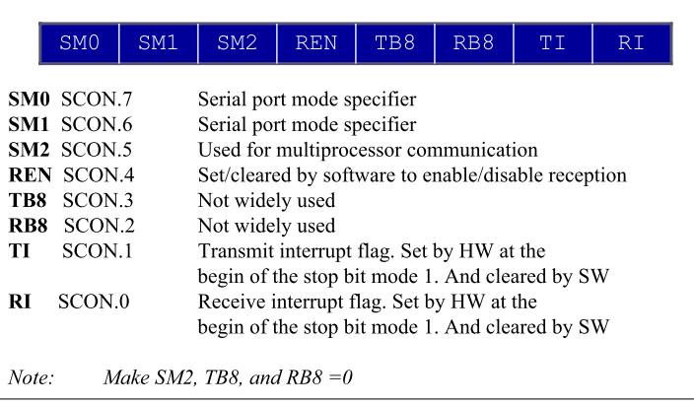
SERIAL COMMUNICATION PROGRAMMING SCON Register
SCON is an 8-bit register used to program the start bit, stop bit, and data bits of data framing, among other things

Slide 40
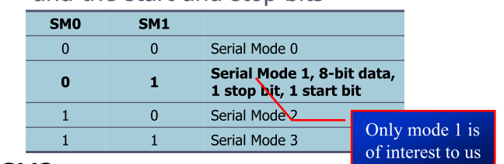
SM0, SM1
They determine the framing of data by specifying the number of bits per character, and the start and stop bits
SM2
This enables the multiprocessing capability of the 8051

Slide 41
REN (receive enable)
It is a bit-addressable register
When it is high, it allows 8051 to receive data on
RxD pin : If low, the receiver is disabled
TI (transmit interrupt)
TI bit is raised at the beginning of the stop bit
When 8051 finishes the transfer of 8-bit character
It raises TI flag to indicate that it is ready to transfer another byte
RI (receive interrupt)
When 8051 receives data serially via RxD, it gets rid of the start and stop bits and places the byte in SBUF register
It raises the RI flag bit to indicate that a byte has been received and should be picked up before it is lost
RI is raised halfway through the stop bit

Slide 42
Programming Serial Data Transmitting
In programming the 8051 to transfer character bytes serially
1. TMOD register is loaded with the value 20H, indicating the use of timer 1 in mode 2 (8-bit auto-reload) to set baud rate
2. The TH1 is loaded with one of the values to set baud rate for serial data transfer
3. The SCON register is loaded with the value 50H, indicating serial mode 1, where an 8-bit data is framed with start and stop bits
4. TR1 is set to 1 to start timer 1
5. TI is cleared by CLR TI instruction
6. The character byte to be transferred serially is written into SBUF register
7. The TI flag bit is monitored with the use of instruction JNB TI,xx to see if the character has been transferred completely
8. To transfer the next byte, go to step 5

Slide 43
Programming Serial Interrupt

Slide 44
To use the serial interrupt the ES bit along with the EA bit is set. Whenever one byte of data is sent or received, the serial interrupt is generated and the TI or RI flag goes high.
TI or RI flag needs to be cleared explicitly in the interrupt routine (written for the Serial Interrupt).
The programming of the Serial Interrupt involves the following steps:
1. Enable the Serial Interrupt (configure the IE register).
2. Configure SCON register
3. Write routine or function for the Serial Interrupt. The interrupt number is 4.
4. Clear the RI or TI flag within the routine.

Slide 45
Send ‘A’ from serial port with the use of interrupt
// Sending ‘A’ through serial port with interrupt
// XTAL frequency 11.0592MHz
void main( )
{
TMOD = 0x20;
TH1 = -1;
SCON = 0x50;
TR1 = 1;
IE = 0x90;
while(1);
}
void ISR_sc(void) interrupt 4
{
if(TI==1)
{
SBUF = ‘A’;
TI = 0;
}
else
RI = 0;
}

Slide 46
Receive data from serial port through interrupt
void ISR_sc(void) interrupt 4
{
unsigned char val;
if(TI==1)
{
TI = 0;
}
else
{
val = SBUF;
RI = 0;
}
}
// XTAL frequency 11.0592MHz
void main()
{
TMOD = 0x20;
TH1 = -1;
SCON = 0x50;
TR1 = 1;
IE = 0x90;
while(1);
}

